Slide 1
Design Patterns

Slide 2
What are design patterns?
Design patterns are typical solutions to common problems in software design. Each pattern is like a blueprint that you can customize to solve a particular design problem in your code.
They keep our system flexible and more maintainable as things change over time.
Principles are aimed at the low level of how we put objects together.
Design patterns are aimed at larger problems.
The first book about design patterns was “Design Patterns: Elements of Reusable Object-Oriented Software”. The four authors of the book: Erich Gamma, Richard Helm, Ralph Johnson, and John Vlissides, have since been dubbed “The Gang of Four”.

Slide 3
Classification of patterns
Creational Patterns | Structural Patterns | Behavioral Patterns
Singleton | Adapter | Chain of Responsibility | State
Builder | Bridge | Command | Strategy
Prototype | Composite | Interpreter | Template Method
Factory Method | Decorator | Iterator | Visitor
Abstract Factory | Facade | Mediator
 | Flyweight | Memento
 | Proxy | Observer

Slide 4
Singleton
Singleton is a creational design pattern that lets you ensure that a class has only one instance, while providing a global access point to this instance.
Use the Singleton pattern when a class in your program should have just a single instance available to all clients; for example, a single database object shared by different parts of the program.
In the spring framework the default scope for bean creation is singleton.
Pros: -you can be sure that a class has only a single instance
-you gain a global access point to that instance
-the singleton object is initialized only when it’s requested for the first time(lazy, we can also implement eager instantiation)

Slide 5
Builder
Builder is a creational design pattern that lets you construct complex objects step by step. The pattern allows you to produce different types and representations of an object using the same construction code.
Pros: - you can construct objects step-by-step, defer construction steps or run steps recursively.
- you can reuse the same construction code when building various representations of products.
- single Responsibility Principle. You can isolate complex construction code from the business logic of the product. Named parameters
If Java had named parameters like in Kotlin, the Builder pattern would be unnecessary, because you could provide only those parameters currently needed to create the object.

Slide 6
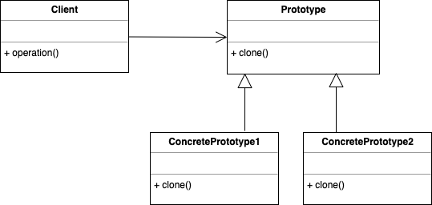
Prototype
Prototype is a creational design pattern that allows cloning objects, even complex ones, without coupling to their specific classes.
All prototype classes should have a common interface that makes it possible to copy objects even if their concrete classes are unknown. Prototype objects can produce full copies since objects of the same class can access each other’s private fields.

Slide 7
Factory Method
Factory method is a creational design pattern which solves the problem of creating product objects without specifying their concrete classes.
Factory Method defines a method, which should be used for creating objects instead of direct constructor call (new operator). Subclasses can override this method to change the class of objects that will be created.

Slide 8
Abstract Factory
Abstract Factory is a creational design pattern, which solves the problem of creating entire product families without specifying their concrete classes.
Abstract Factory defines an interface for creating all distinct products but leaves the actual product creation to concrete factory classes. Each factory type corresponds to a certain product variety.
The client code calls the creation methods of a factory object instead of creating products directly with a constructor call (new operator). Since a factory corresponds to a single product variant, all its products will be compatible.
Client code works with factories and products only through their abstract interfaces. This lets the client code work with any product variants, created by the factory object. You just create a new concrete factory class and pass it to the client code.

